Slide 1
Dataset Description
The Netflix prize dataset is 2.7 Gigabytes and distributed in files in the form given below:
Training data set: It is directory containing 17,770 files with a single file per movie. The first line of each file contains the movie id followed by a colon and each subsequent line in the file corresponds to a rating from a customer, as shown below:
Format: [CustomerID, Rating, Date]
· MovieIDs range from 1 to 17770 sequentially.
· CustomerIDs range from 1 to 2649429, with gaps. There are 480189 users.
· Ratings are on a five star scale from 1 to 5.
· Dates have the format YYYY-MM-DD.

Slide 2
Dataset Description contd..
Movie Titles dataset: This is a dictionary file which consists of information about each movie i.e the movie id followed by year of release and title of the movie.
Format : [MovieID, YearOfRelease, Title]

Slide 3
Modifications in Dataset
Used Omdb Rest-API to get the genres for each movie in dataset for more analysis results.
Movie genres file created:
- Format : [MovieID, Genres]
Combined all the 17770 files in the training data set and created single file with:
- 100 million entries.
- Format : [MovieID, CustomerID, Rating, Date]

Slide 4
Steps taken
Setting up a 2 node hadoop cluster using LAN wires and ethernet hub.
Storing the data into hdfs and Hbase, Hive.
Performed analysis on the data using tools and technologies provided by hadoop-eco system and storing the results.
Performed machine learning analysis and comparison between spark and hadoop.
Used Tableau Business Intelligence tool for the data visualization and charts.

Slide 5
Technologies Used
Hadoop Eco-System
Performed Map Reduce on 􏰄HDFS
Pig – Performed map-reduce
HBase – Storing data and results.
􏰄Hive – Data Warehousing and Analysis
Mahout – Machine Learning Analysis
Spark – Comparative analysis

Slide 6
Architecture
Mahout
HBase
Pig
Hive
Map Reduce
HDFS

Slide 7
Map Reduce Analysis
Tasks performed (5 Map Reduce Java Programs):
Grouping the movies by genres.
Calculate the average rating and count of ratings for a customer.
Calculate the average rating of a movie.
Number of users in each year
Number of users in each year and corresponding months.

Slide 8
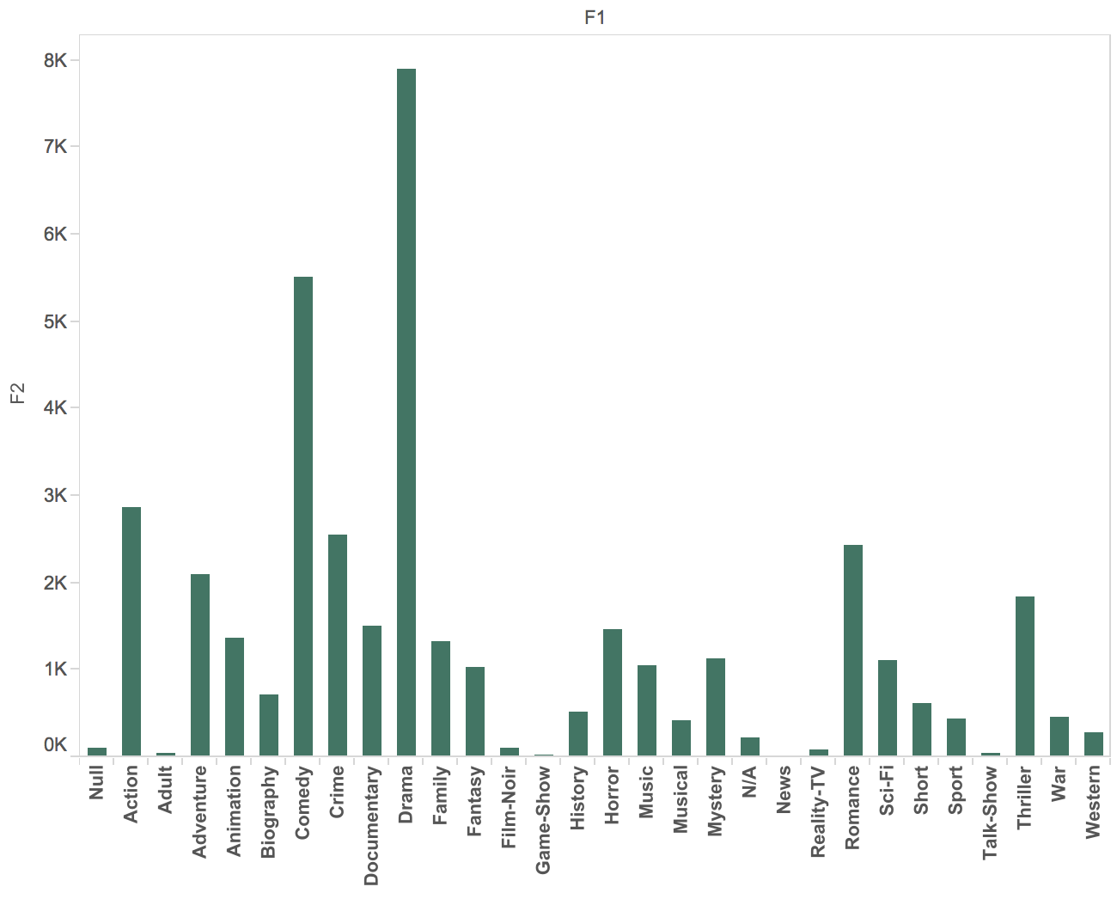
Map Reduce Analysis
Grouping the movies by genres, takes 3 seconds (movie count vs genre)

Slide 9
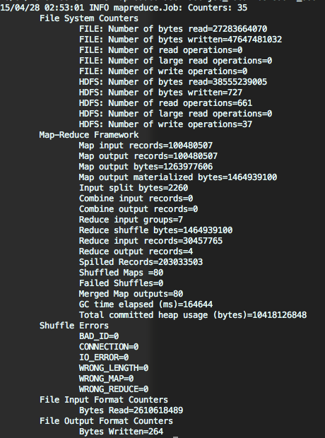
Map Reduce Analysis
Performance of the average rating and count of ratings for a customer.
Execution
Time : 11 mins

Slide 10
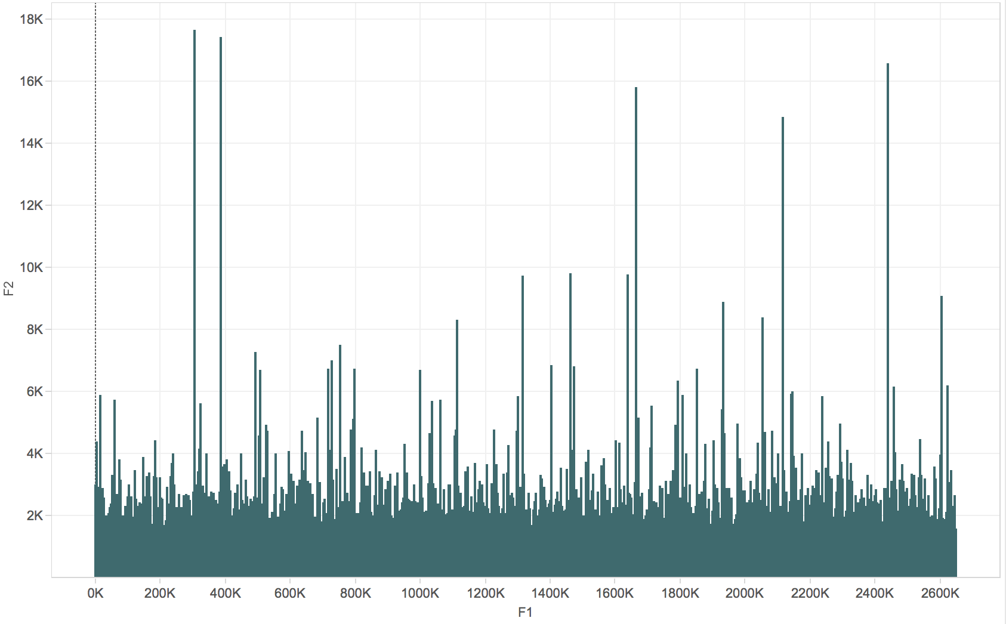
Rating count per customer

Slide 11
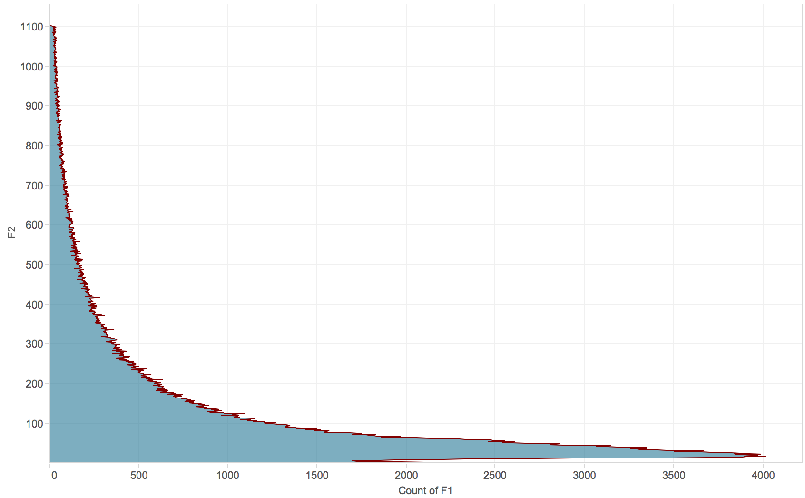
Rating count in descending order
In order to make the tail of the graph visible, rating counts
for top 10,000 customers are trimmed.

Slide 12
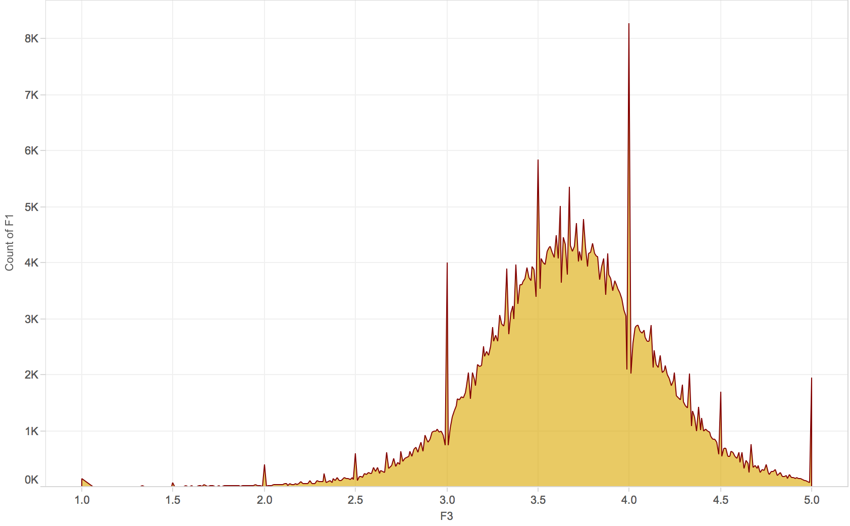
Customer distribution by ratings

Slide 13
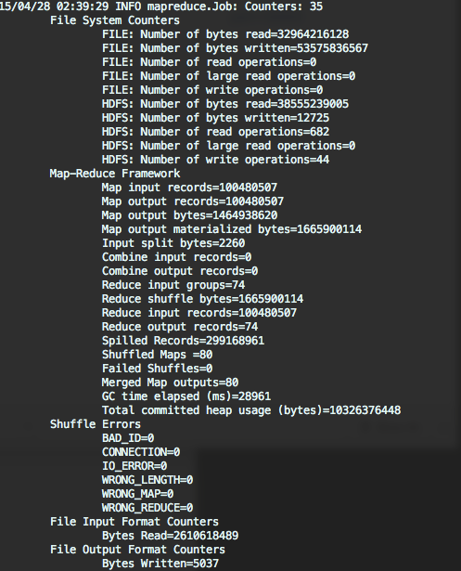
Map Reduce Analysis
Number of users in each year and corresponding months.
Execution Time:
9 mins

Slide 14
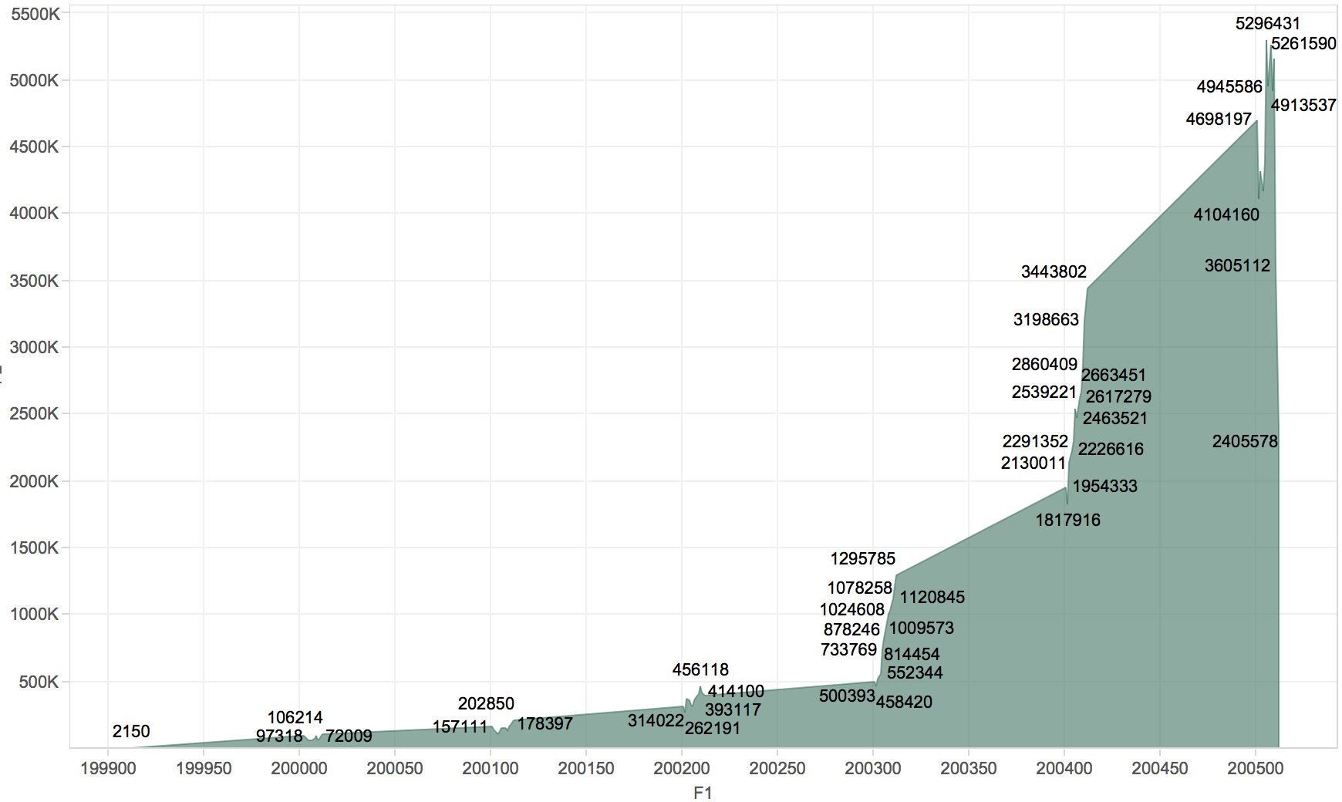

Slide 15
Analysis Using Pig
Tasks performed (6 pig scripts) :
Average movies ratings.
Movie count by release year
Users/ratings count for each movie
Popular movie by release year based on average ratings.
Top 10 customers based on average ratings.
Ratings count per customer.

Slide 16
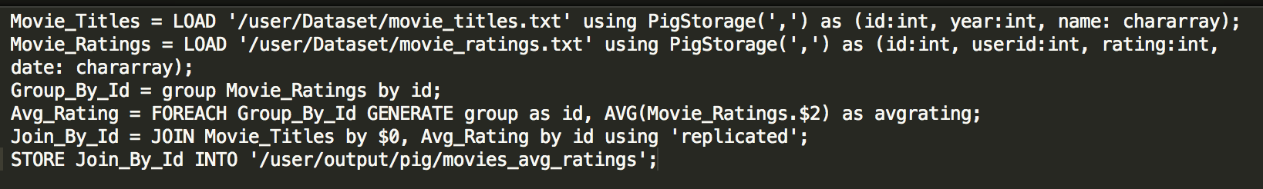
Pig Analysis
Average movies ratings.
Pig Script :
Query Performance :
Running time : 8mins 48 secs

Slide 17
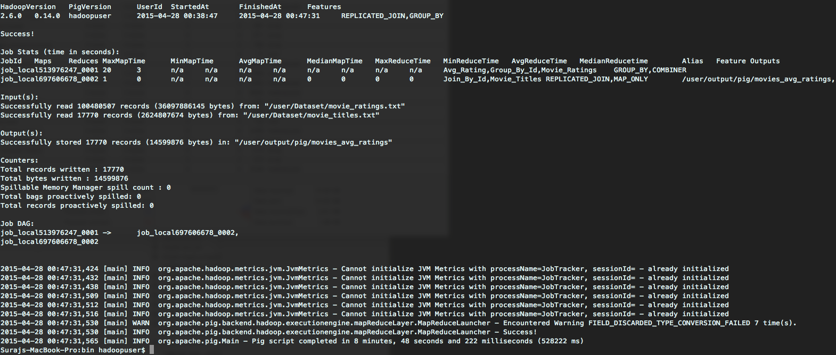
Pig Analysis
Query Performance:

Slide 18
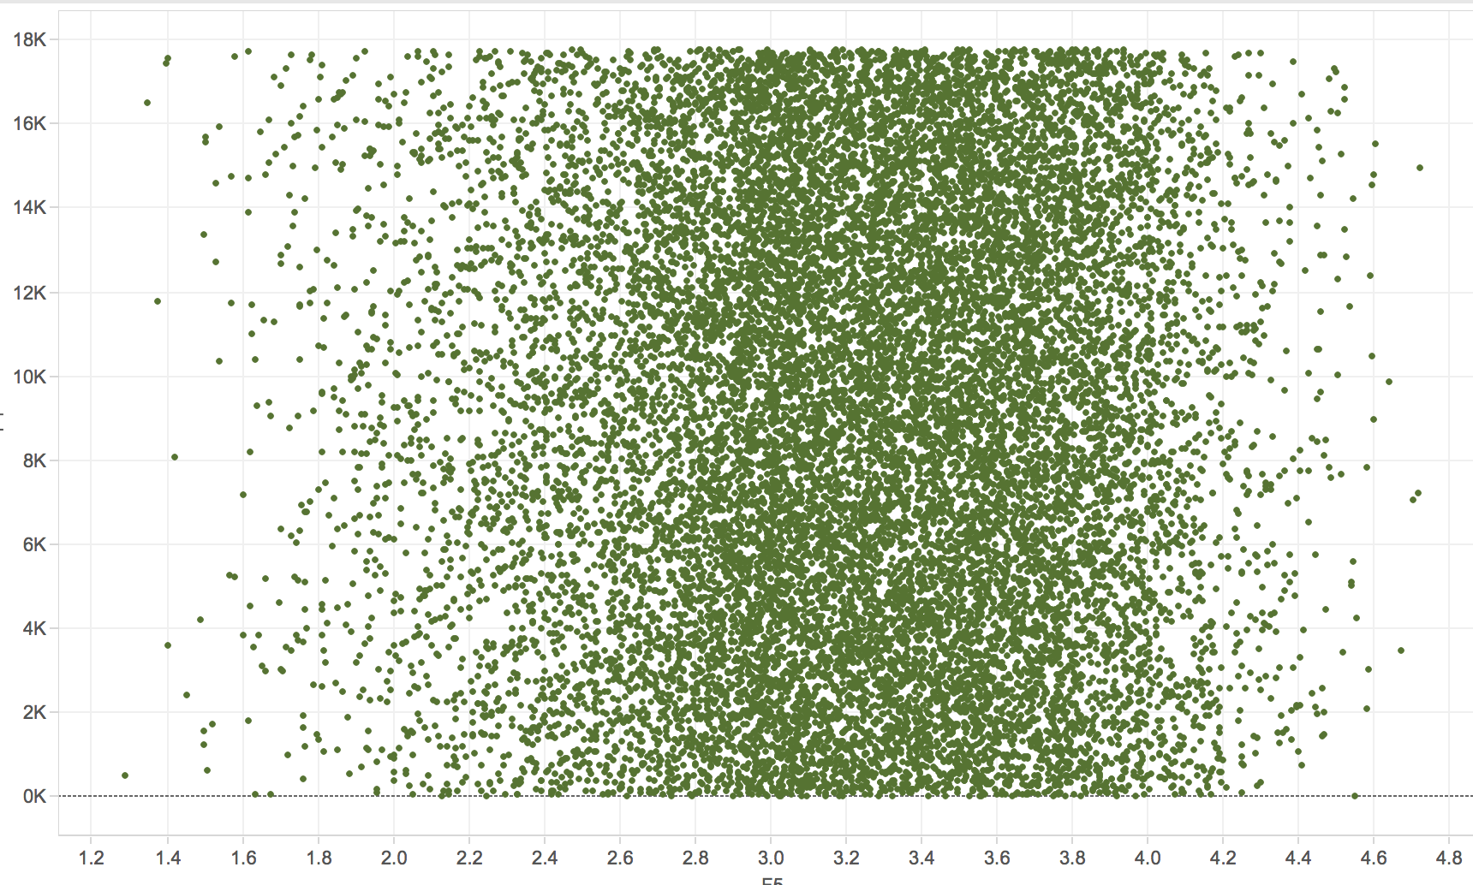
Movie distribution by ratings

Slide 19
Pig Analysis
Movie count by release year
Pig Script:
Query Performance:
12 secs

Slide 20
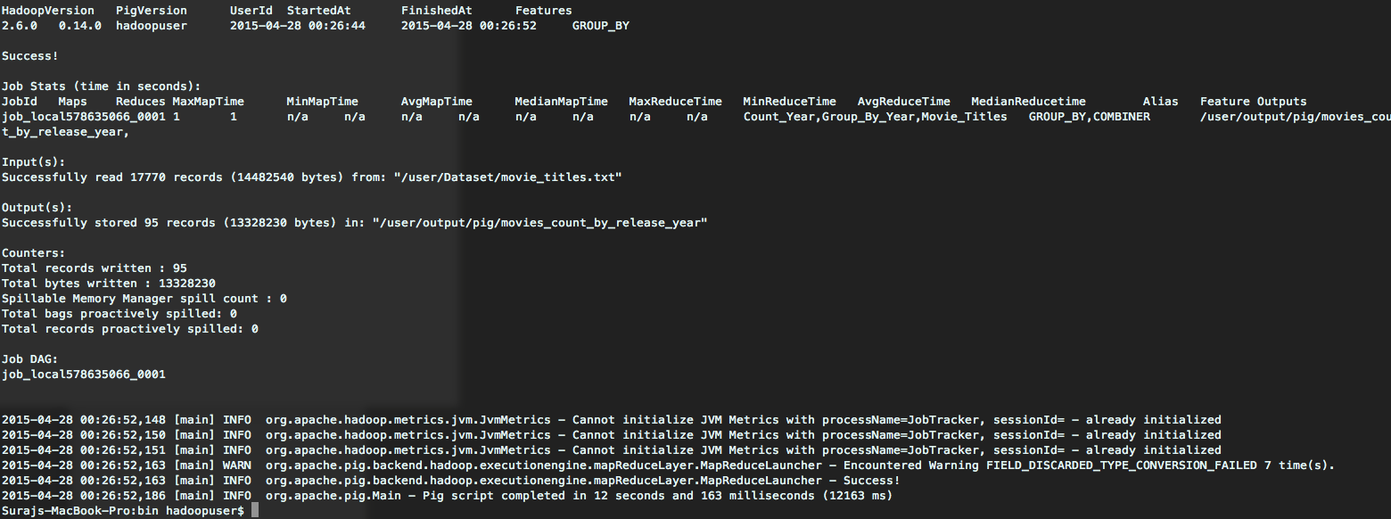
Pig Analysis
Query Performance:

Slide 21
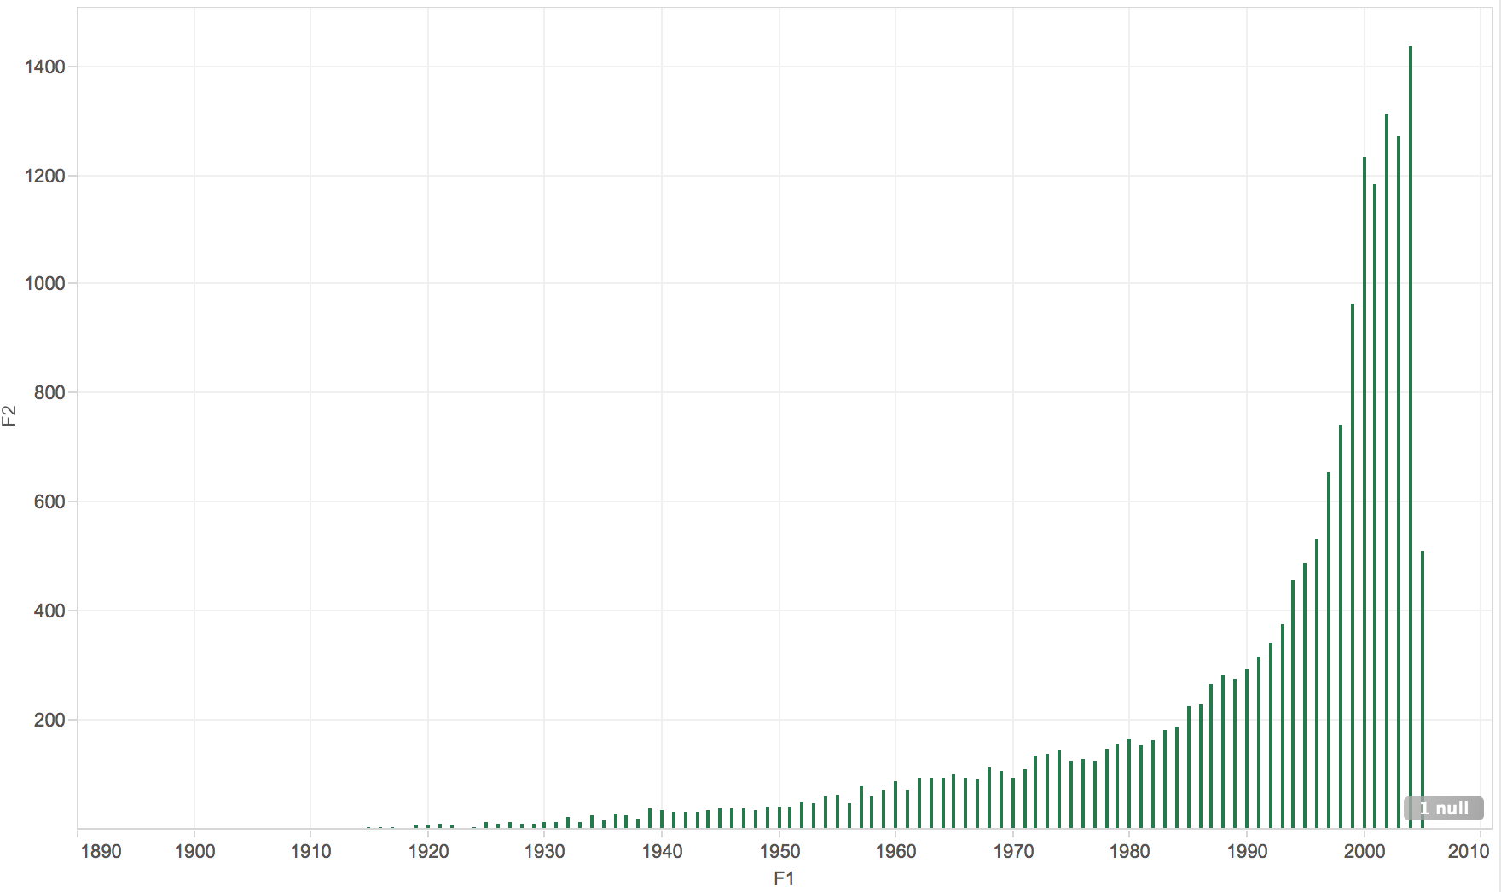
Movie count vs Release year

Slide 22
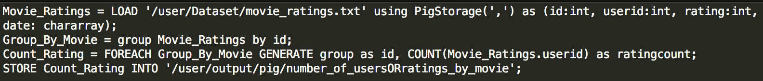
Pig Analysis
Users/ratings count for each movie
Pig Script:
Query Performance:
8 mins, 26 secs

Slide 23
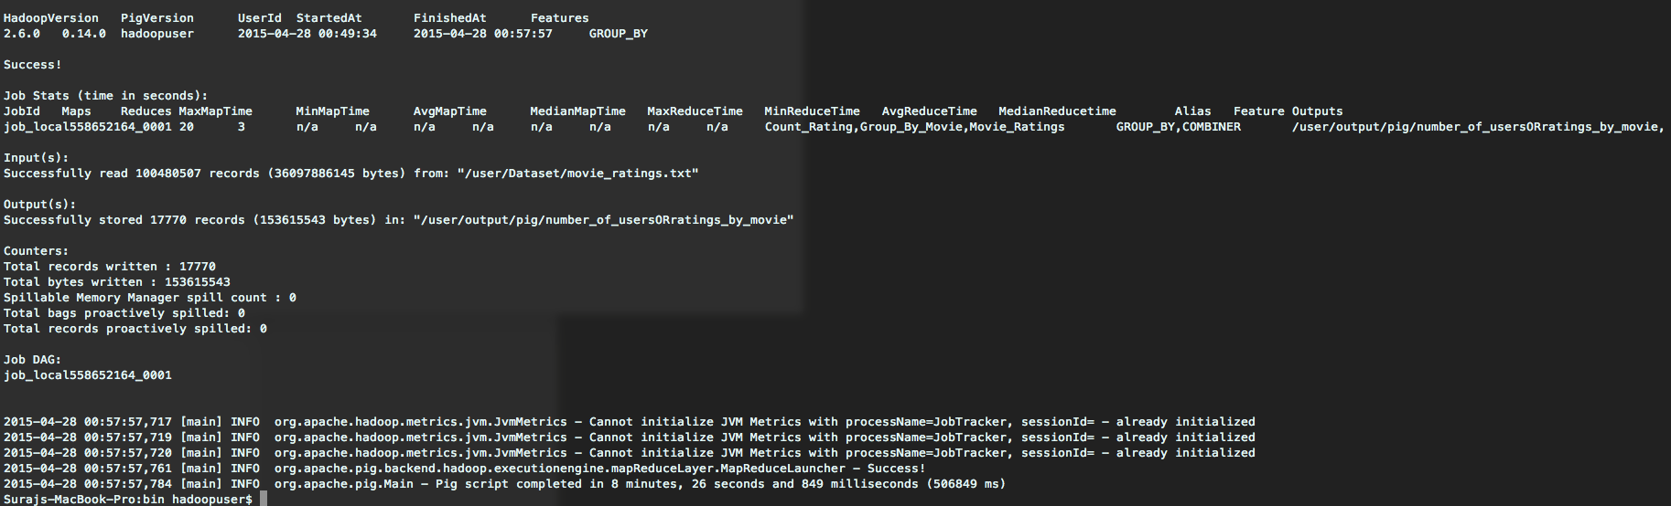
Pig Analysis
Query Performance:

Slide 24
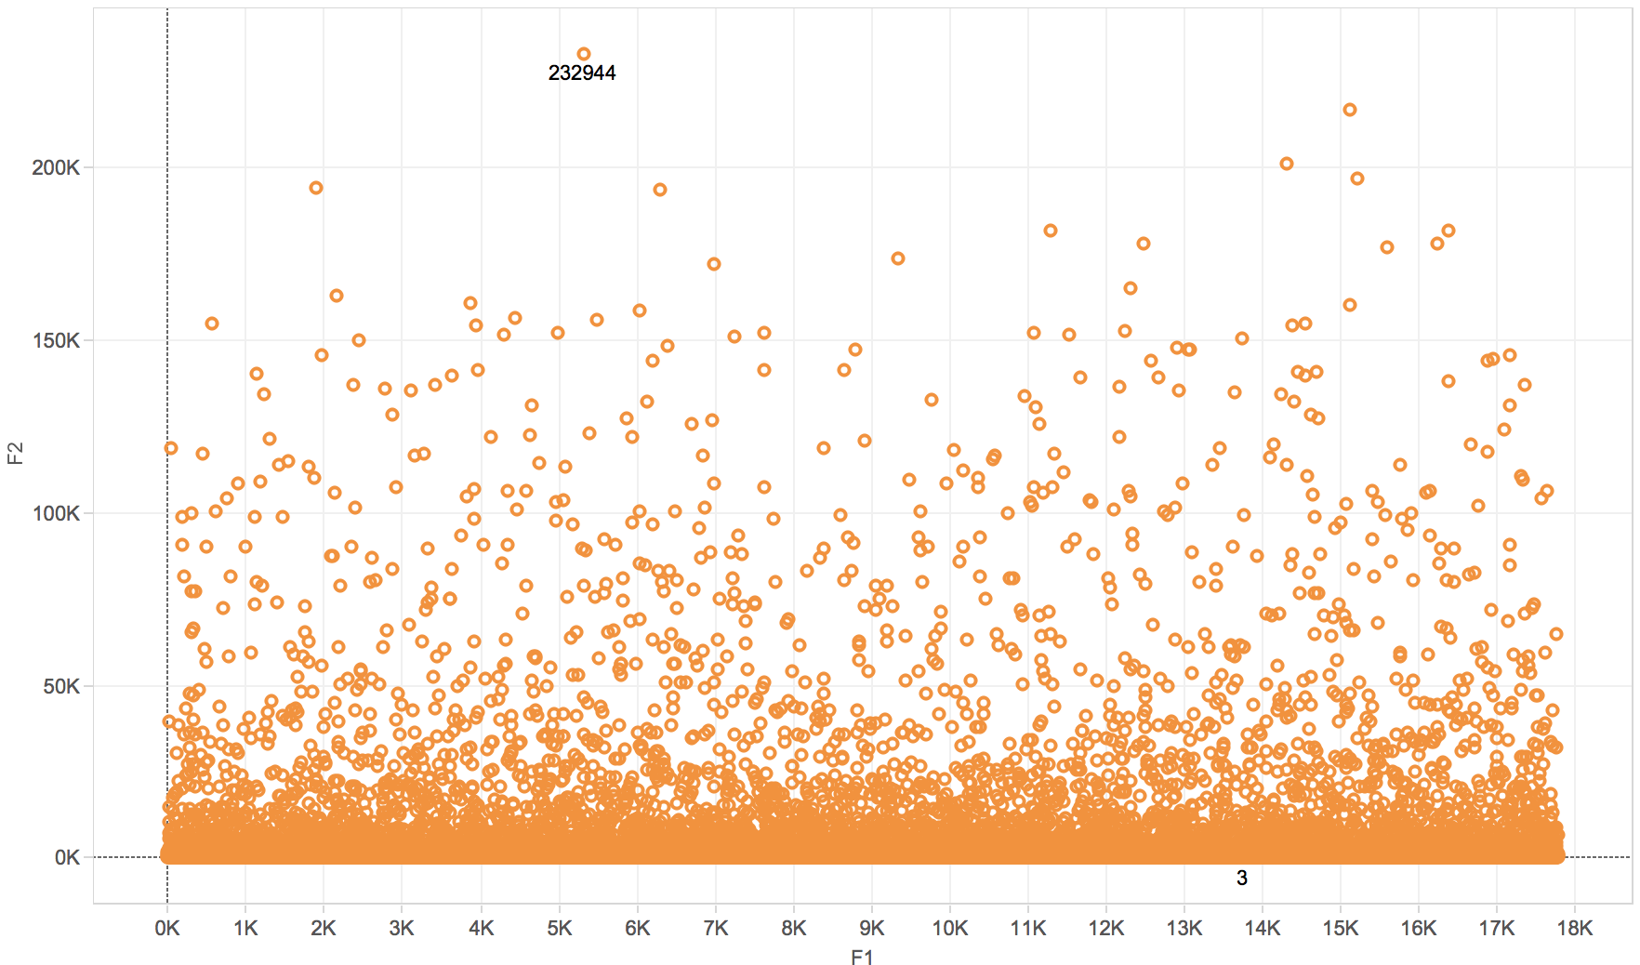
Movie Ratings count vs MovieId

Slide 25
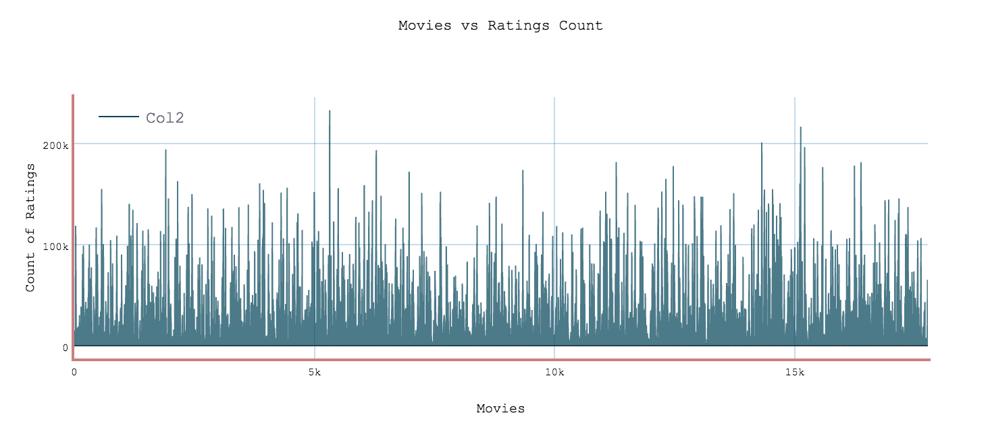
Movie Ratings count vs MovieId
Another representation

Slide 26
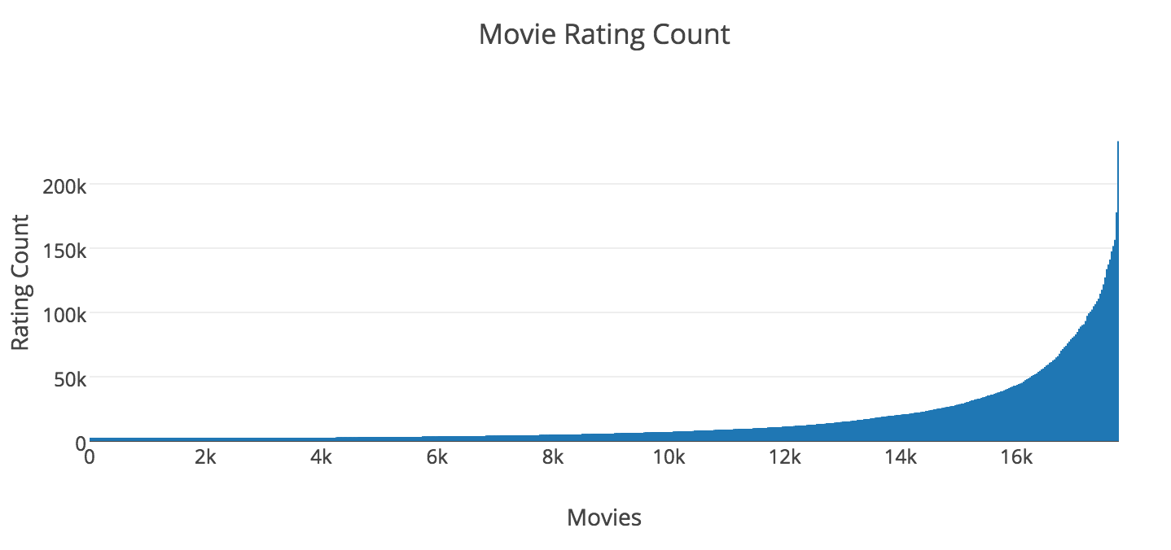
Movie Ratings count (sorted asc) vs Movie count

Slide 27
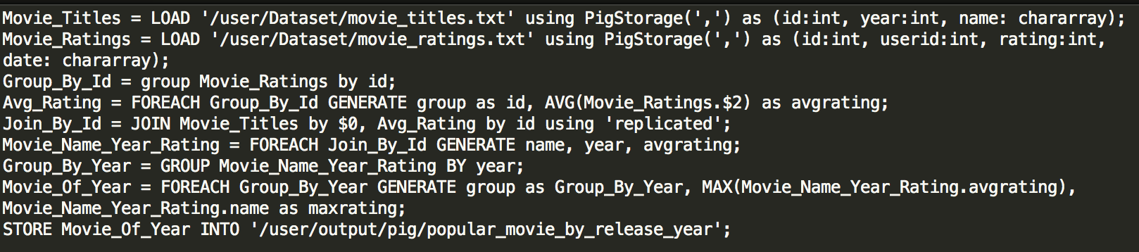
Pig Analysis
Popular movie by release year based on average ratings.
Pig Script:
Query Performance:
8mins 52 secs
10 mins 30 secs (without, replicated)

Slide 28
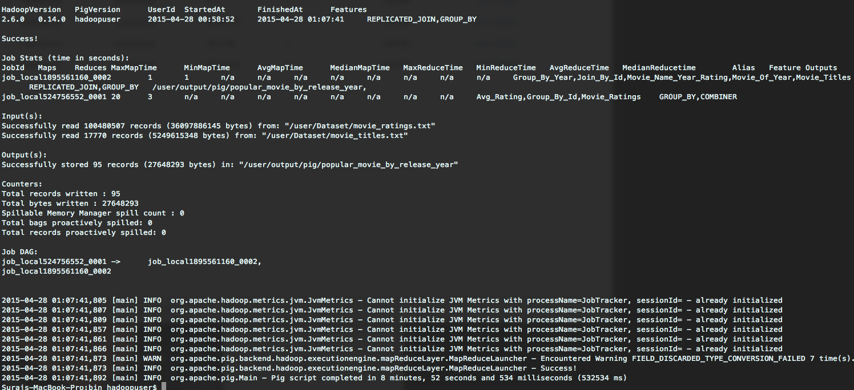
Pig Analysis
Using replicated join:

Slide 29
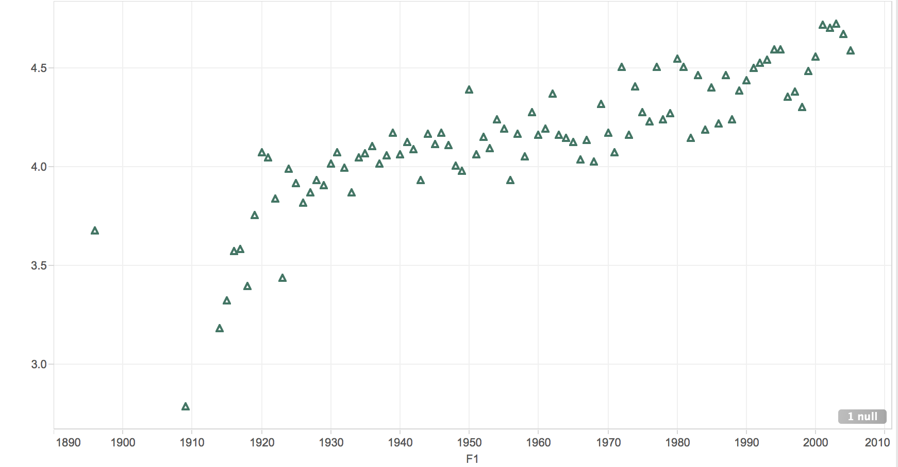
Highest rated movie vs Release year

Slide 30
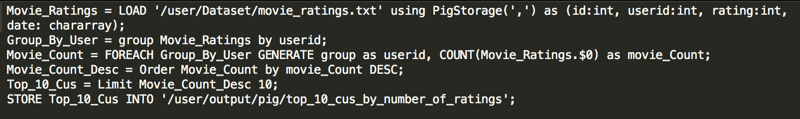
Pig Analysis
Top 10 customers based on average ratings.
Pig Script:
Query Performance:
12mins 59 secs

Slide 31
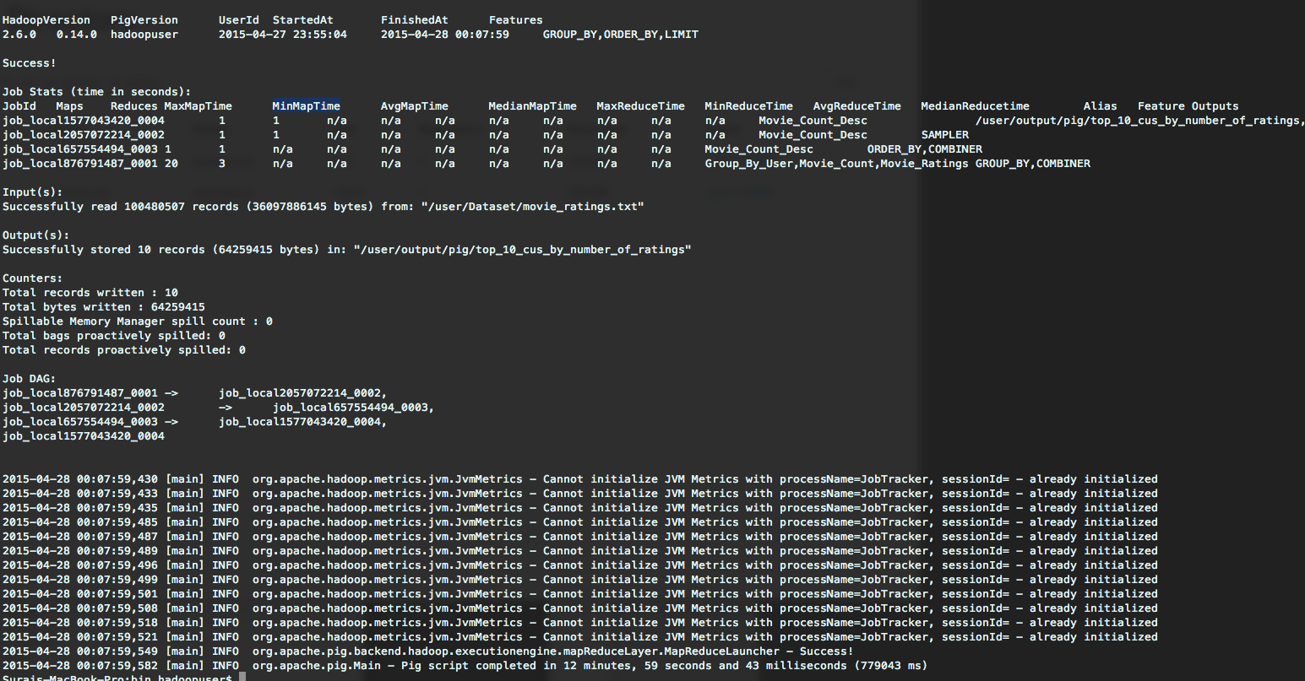
Pig Analysis

Slide 32
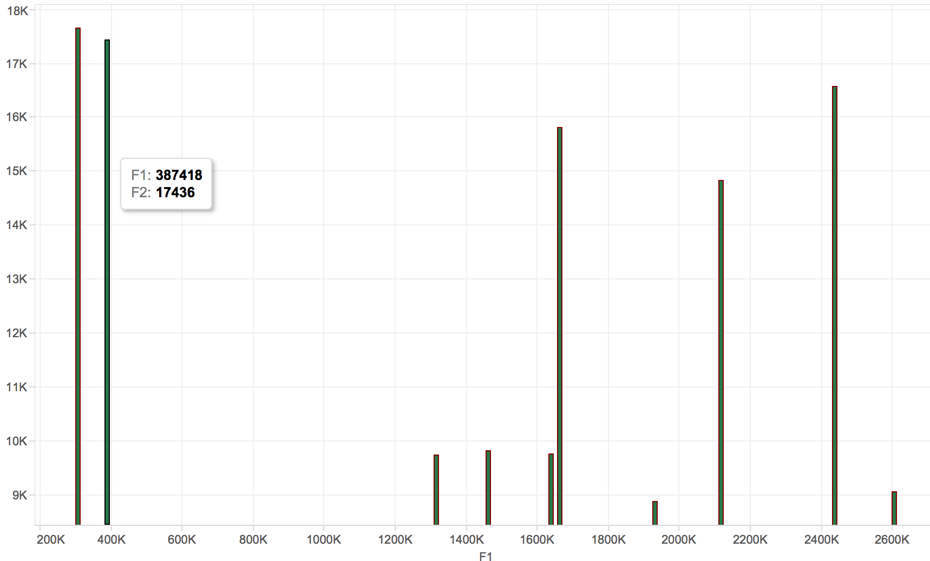
Rating count vs Customer

Slide 33
Analysis Using HIVE
Tasks performed :
Movie of the decade.
Movie Popularity Distribution
Customer Rating Distribution

Slide 34
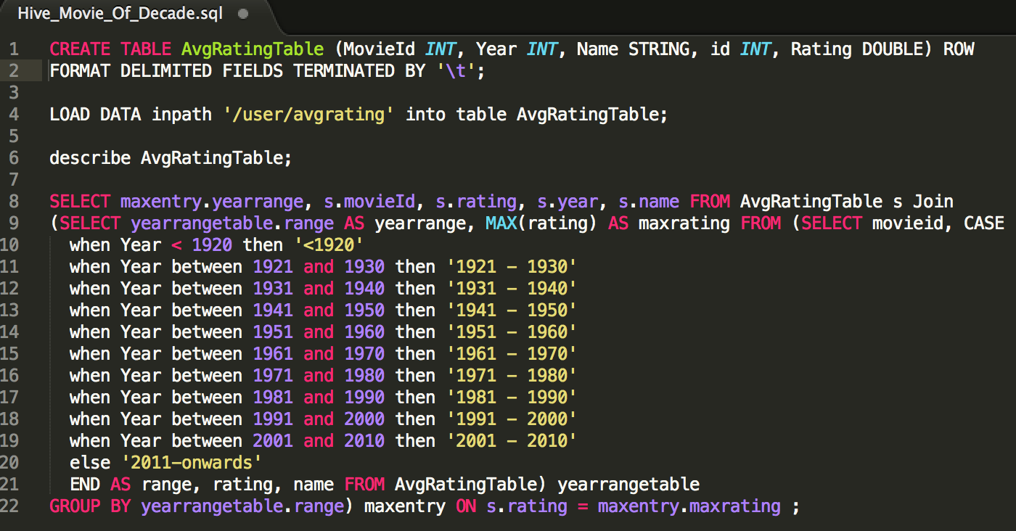
HIVE Analysis
Finding movie of the decade.
HQL:

Slide 35
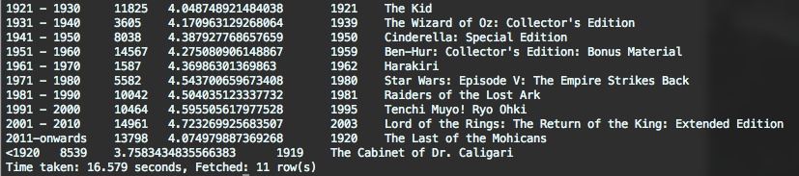
HIVE Analysis
Running hive query and saving the result in csv file:
$hive –f “Hive_Movie_Of_Decade.sql” > ~/output.csv
Query output :

Slide 36
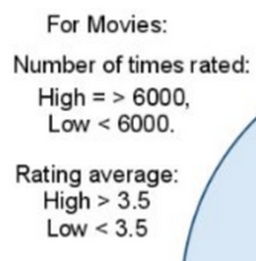
HIVE Analysis
Movie Popularity Distribution:
X= rating count of movie
Y = average movie rating
Low,High
High, High
(6000, 3.5)
Low, Low
High, Low

Slide 37
HIVE Analysis
Movie Quadrant Descriptions:
1st Quadrant: First quadrant consists of those movies which have received high number of ratings by users and also have been rated very highly. It can be predicted that these movies have a good probability of receiving a high rating by the targeted user.
2nd Quadrant: Second quadrant consists of movies that have received
low number of ratings by users and have been rated very low. A definitive conclusion about this set of movies and predicted ratings cannot be made.
3rd Quadrant: Third quadrant consists of movies that have received low number of ratings by users but have been rated very highly. A definitive conclusion about this set of movies and predicted ratings cannot be made.
4th Quadrant: Fourth quadrant consists of movies that have received high number of ratings by users but have been rated very low. It can be predicted that these movies have a good probability of receiving a low rating by the targeted user.

Slide 38
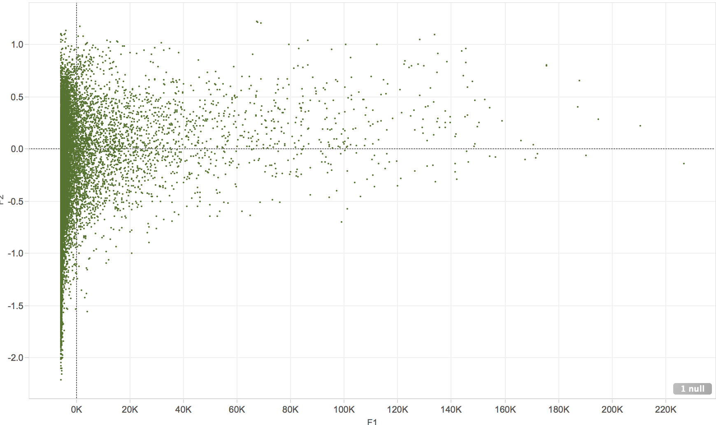

Slide 39
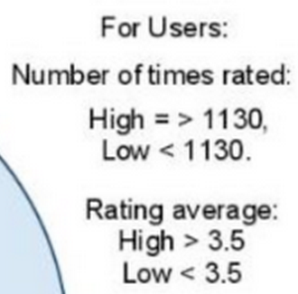
HIVE Analysis
Customer Rating Distribution:
X= rating count of customer
Y = Average customer rating
Low, High
High, High
(1130, 3.5)
Low, Low
High, Low

Slide 40
HIVE Analysis
User Quadrant Descriptions:
1st Quadrant: First quadrant consists of those users who have watched high number of movies and also have a high average rating. It can be concluded that the users in this quadrant have a higher credibility when it comes to rating a movie.
2nd Quadrant: Second quadrant consists of those users who have watched low number of movies and have rated them low. It can be concluded that the users in this quadrant do not give credible ratings
3rd Quadrant: Third quadrant consists of those users who have watched low number of movies but have rated them highly. It can be concluded that the users in this quadrant are occasional movie watchers.
4th Quadrant: Fourth quadrant consists of those users who have watched high number of movies but have a low average rating. It can be concluded that the users in this quadrant do not like the movies they have watched, or in other words, they are strict movie critics.

Slide 41
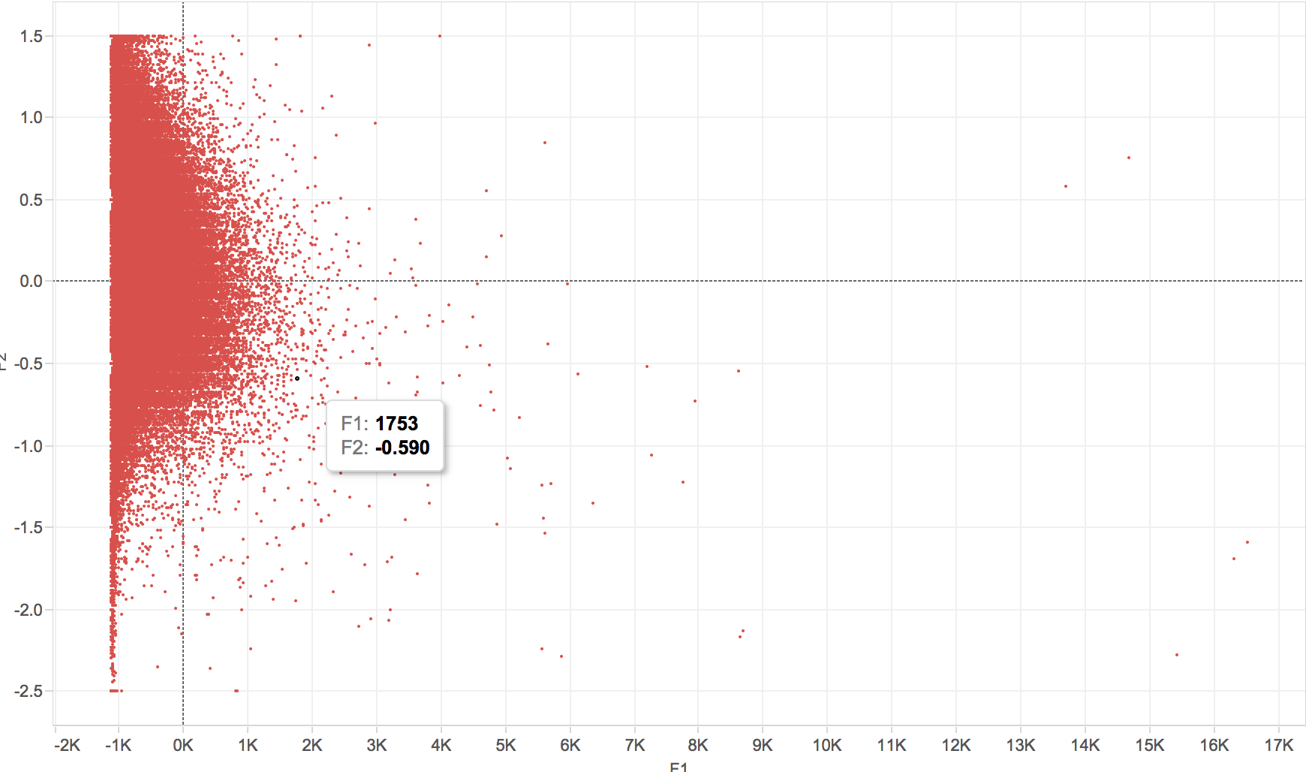

Slide 42
Mahout Machine Learning Analysis
Recommendation(Collaborative filtering)
User-based Recommendation
Item-based Recommendation
K-means clustering

Slide 43
Mahout Machine Learning Analysis
Item Recommendation steps taken are:
Create data model.
Pearson Correlation Similarity Algorithm, for more efficiency, we could define a list pre-defined correlations using GenericItemsimilarity
Initialize the recommender
Generate the recommendations

Slide 44
Mahout Machine Learning Analysis
User Recommendation steps taken are:
Create data model.
Pearson Correlation Similarity Algorithm.
Use NearestNUserNeighborhood to calculate the neighbors of users.
Initialize the recommender
Generate the recommendations

Slide 45

Mahout Machine Learning Analysis
K-means clustering steps taken:
Step1: Convert the input text to sequences -> binary sequence file
Step2: Convert the generated sequence to sparse vector using seq2sparse, perform the TF-IDF transformation
Step3: Run the KMeans cluster
Step4: Dump the results to file
Step5: Dump the Document to cluster mapping

Slide 46
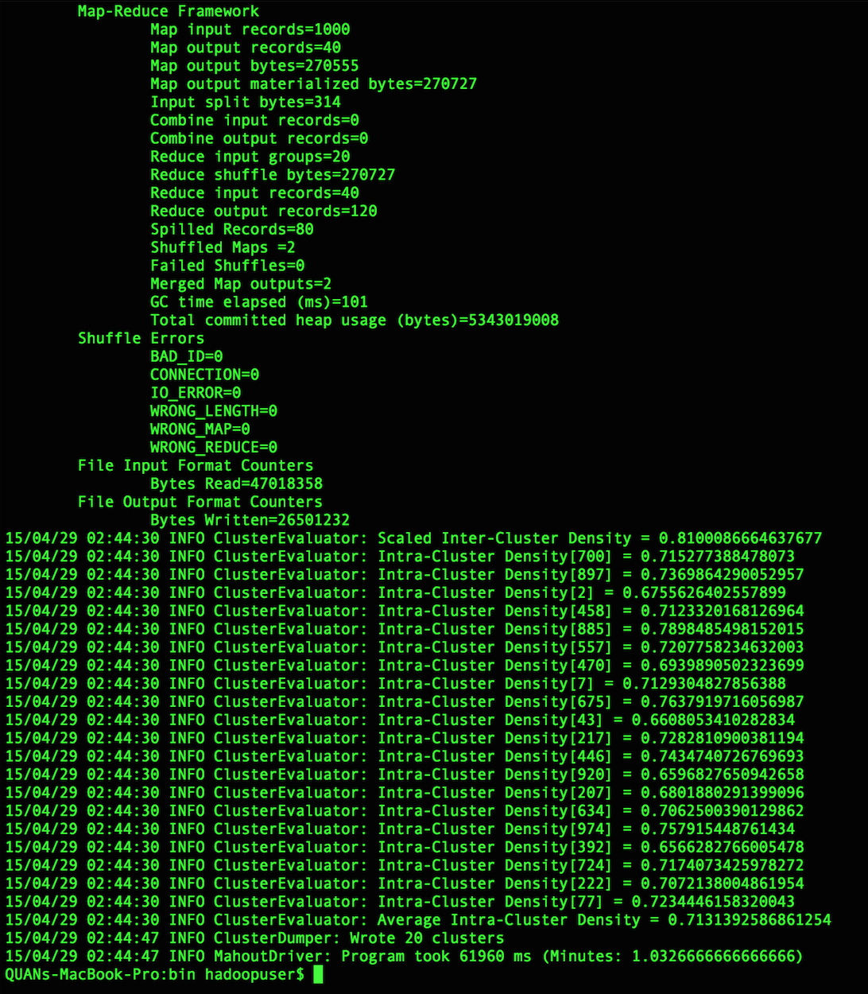
Success screenshot for k-means cluster
Number of clusters created

Slide 47
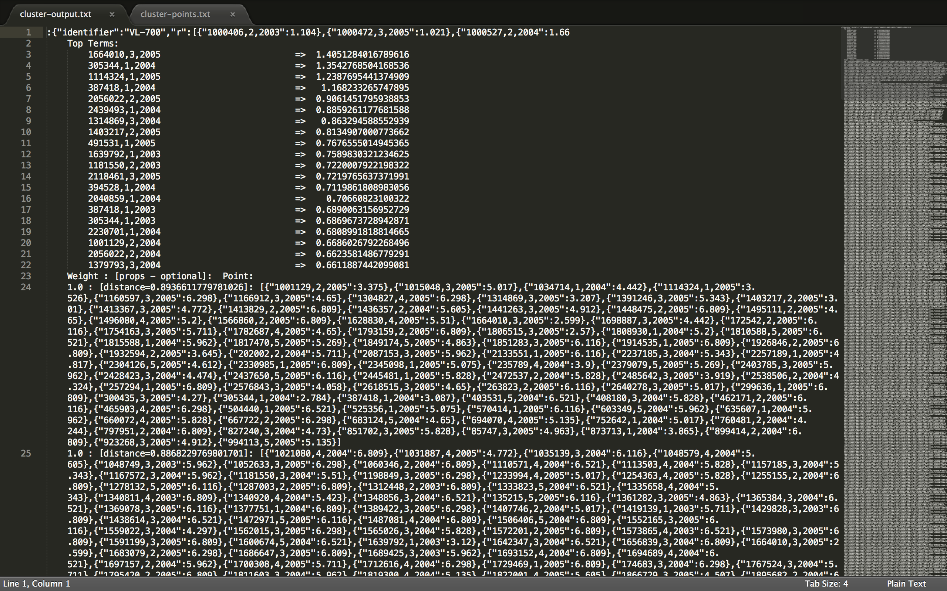
Cluster Dump (Top of the file)

Slide 48
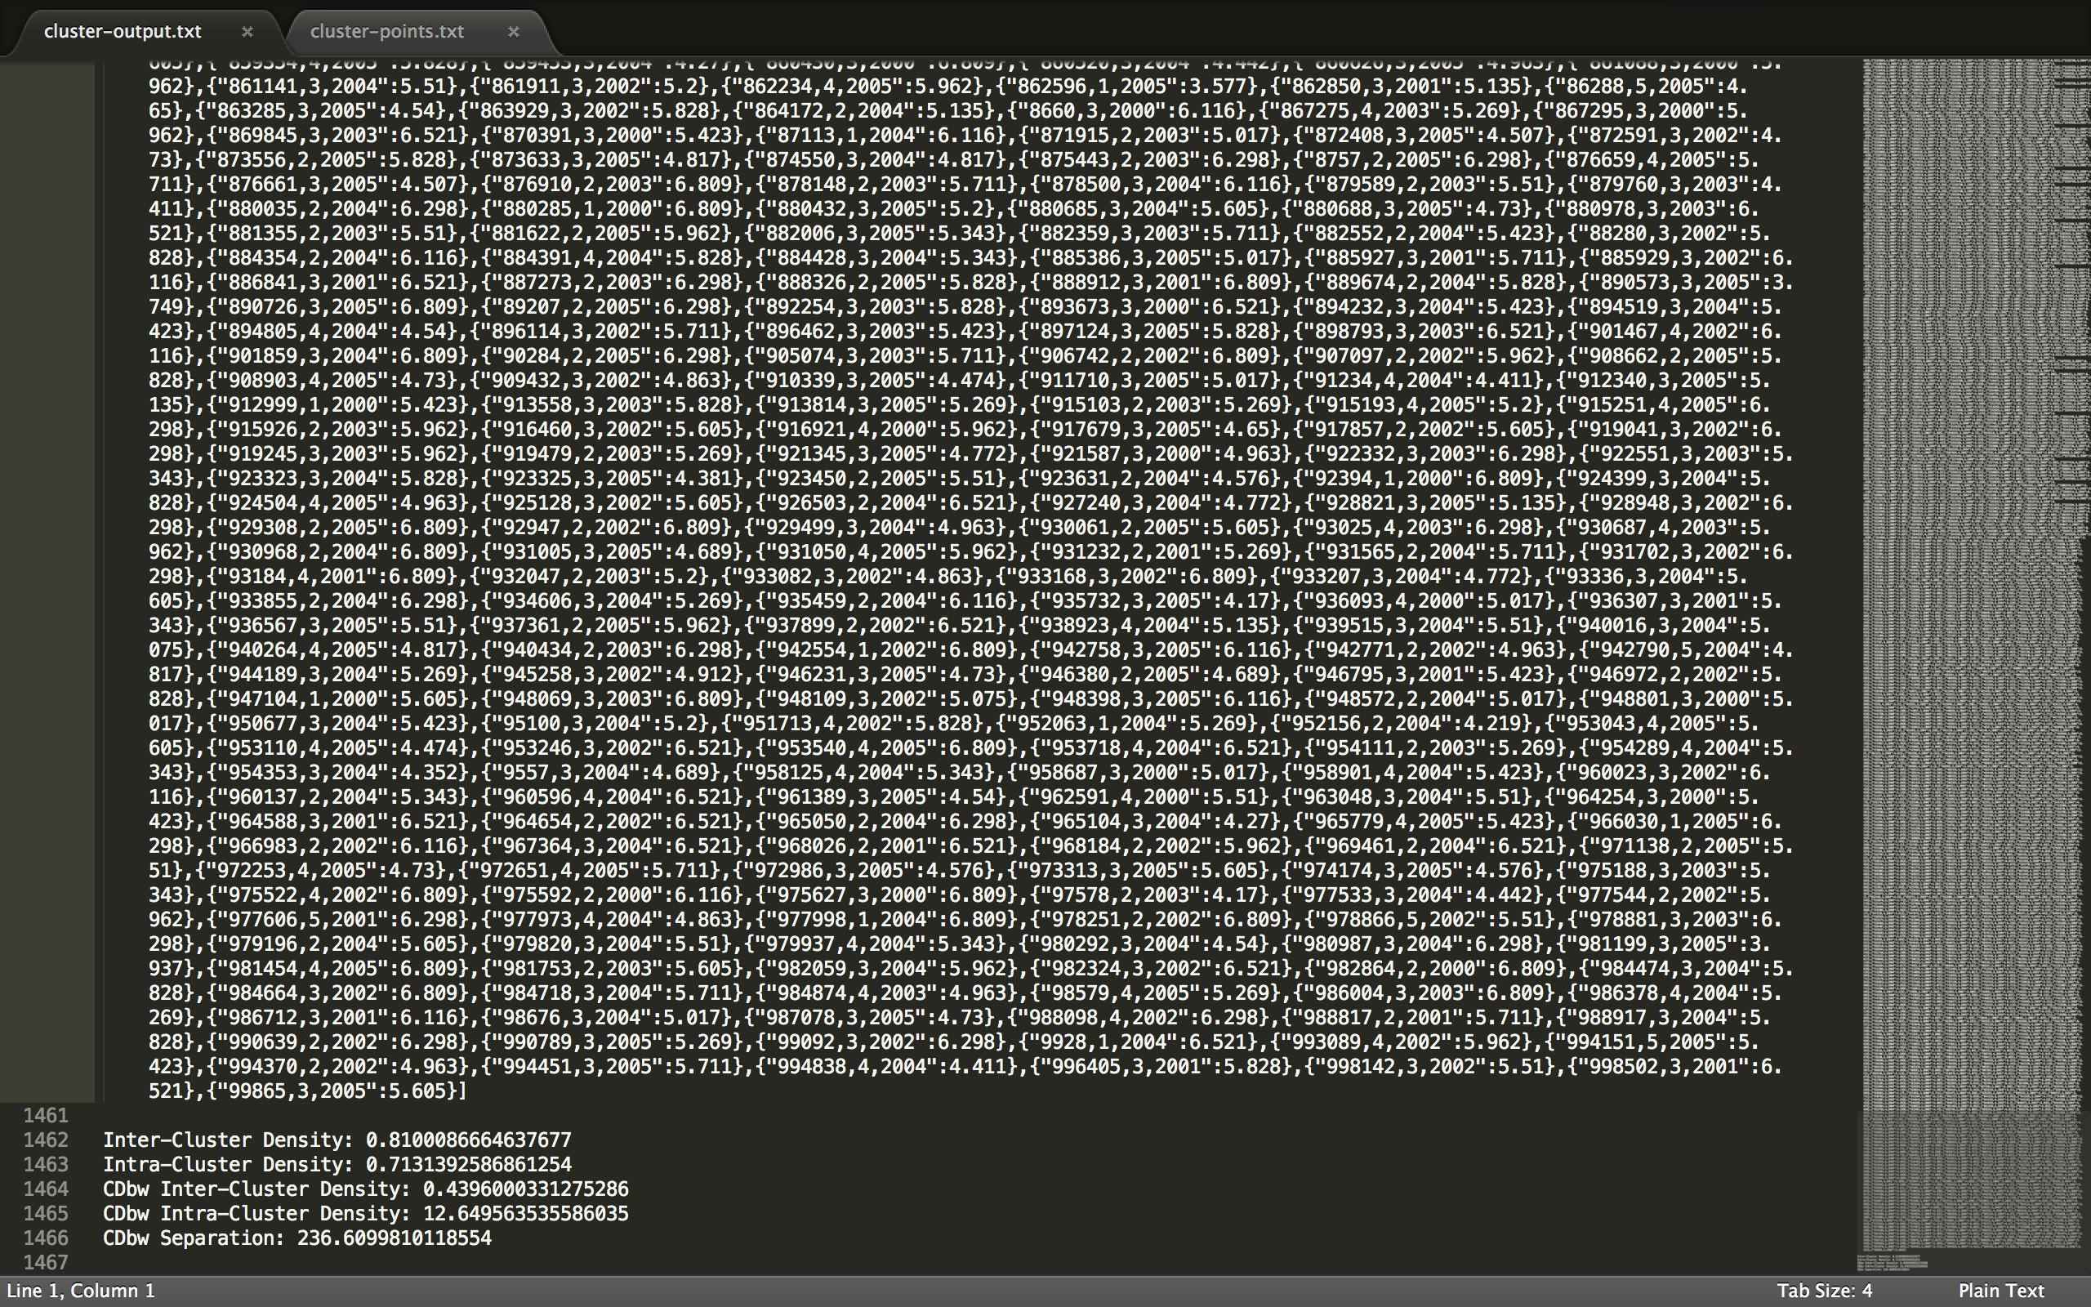
Cluster Dump (Bottom of the file)

Slide 49
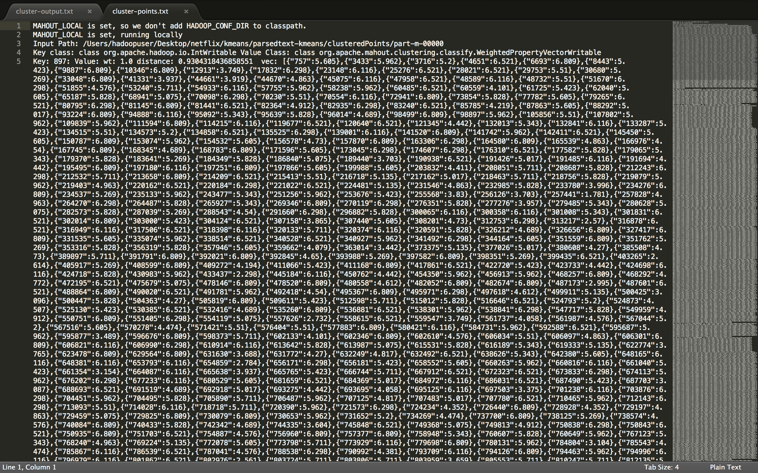
Cluster Points (Topof the file)

Slide 50
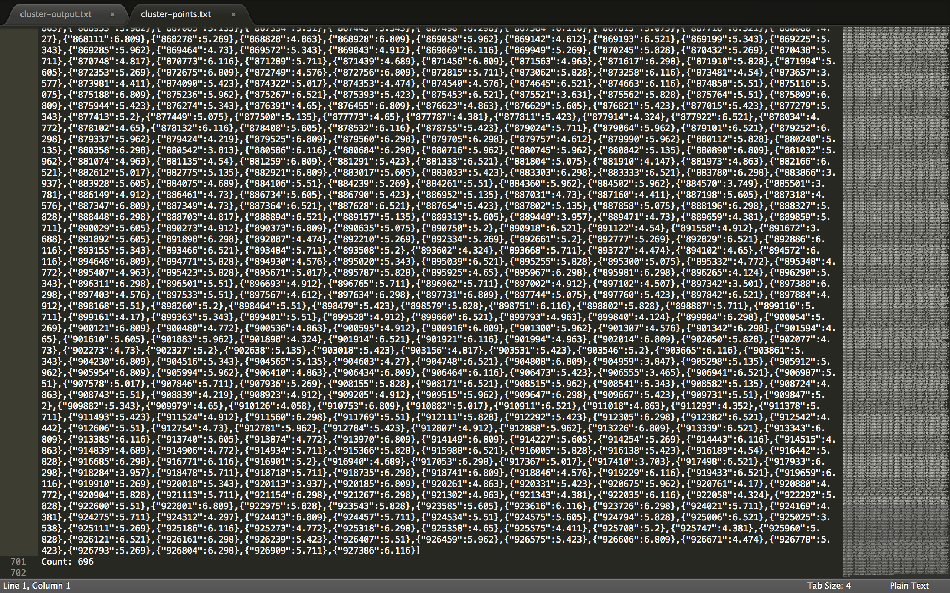
Cluster Points(Bottom of the file)

Slide 51
Mahout Machine Learning Analysis
Problems encountered in Mahout:
Running 100 million records from 17770 files will cause the Sequence process run out Heap Memory 􏰀
Solutions:
Store those files into several directories and do more sequence process jobs may solve the problem

Slide 52
Spark Analysis
Group Movies by Month
Count of ratings per customer

Slide 53
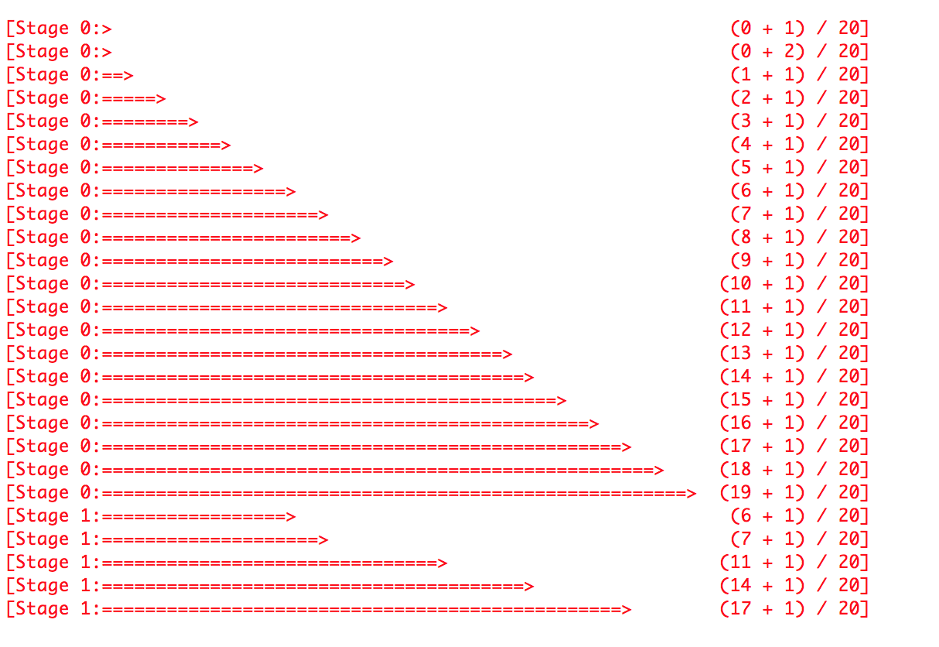
Spark Analysis
Group Movies by Month
Query running time : 2min 1 secs

Slide 54
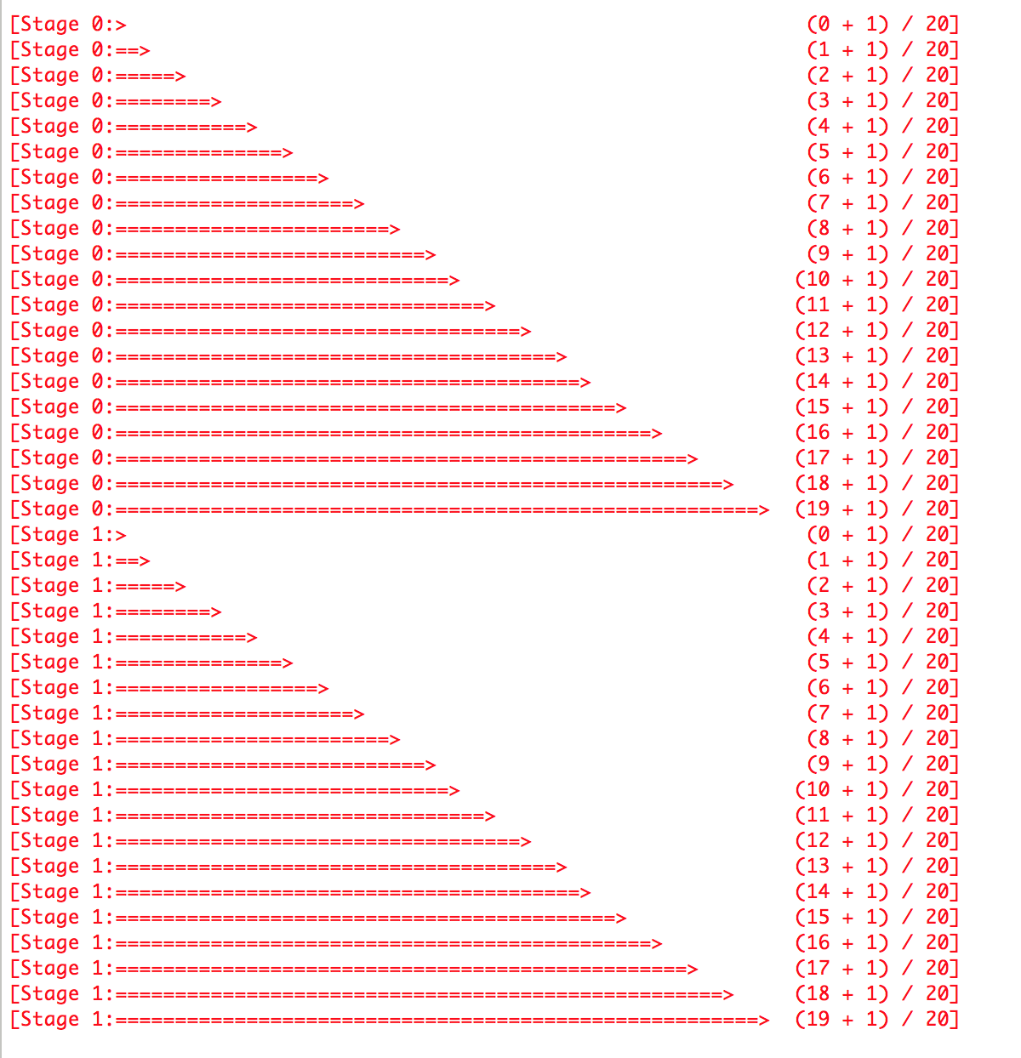
Spark Analysis
Ratings count per user
Query running time : 2min 1 secs

Slide 55
Spark vs Hadoop vs Pig
Performance Analysis:
 | Spark | Hadoop | Pig
Group Movies by Month [File size: 2.6GB, Number of lines: 100million] | Time taken 2min 1sec – Create 20 output files | Time taken – 9 mins 13 secs Created 4 ouptut files – 1 per reducer | --
Ratings count per customer [File size: 2.6GB, Number of lines: 100million] | Time taken 2min 1sec – Create 20 output files | Time taken – 11 mins 10 secs Created 4 ouptut files – 1 per reducer | Time taken – 13 mins 13 secs

